Slide 1
Stream Ciphers Striving for Randomness
Larysa Bondar
Simon Thalmaier
Carl Schünemann
Notes:
Begrüßung
Thema zu Webtechnologien
Vor allem WebAssembly, Progressive Web Apps, Single Page Applications
Unscheinbar: LAMP is now MEAN
LAMP und MEAN: Akronyme für einen Stack an Webtechnologien (Stack == aufeinander bauende Softwarekomponente)
Ist LAMP noch Sinnvoll wenn es MEAN gibt? Vorteile von MEAN? Bzw. hat LAMP vlt Vorteile zu MEAN?
Deswegen Thema ausgewählt
Erste Frage: Was steckt hinter LAMP und MEAN

Slide 2
“Any one who considers arithmetical methods of producing random digits is, of course, in a state of sin.”
John von Neumann, summarized by George E. Forsythe, 1951 [2, p. 36]

Slide 3
Stream Ciphers: Striving for Randomness
Presentation Overview
The Idea of Stream Ciphers
Linear Feedback Shift Registers
Security of Stream Ciphers Based on LFSRs
Increasing the Cryptographic Qualities of LFSRs
The eSTREAM Contest
Trivium

Slide 4
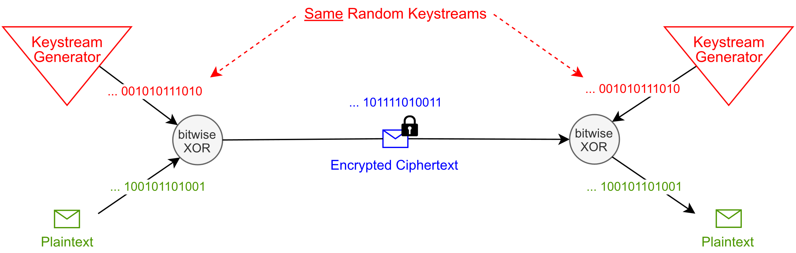
The Idea of Stream Ciphers
Stream Cipher: A Symmetric Cipher
How can random keystreams be generated?
How can two identical keystreams be generated?
Based on: [4, p. 232]

Slide 5
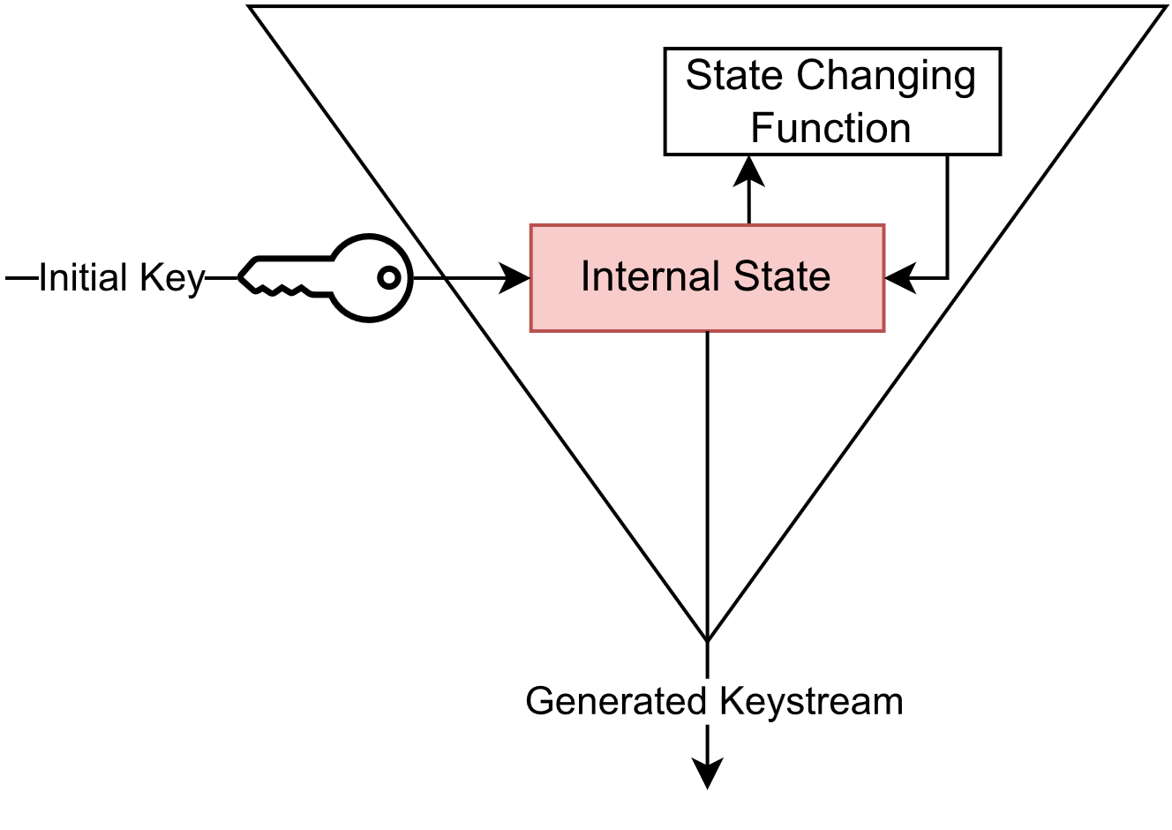
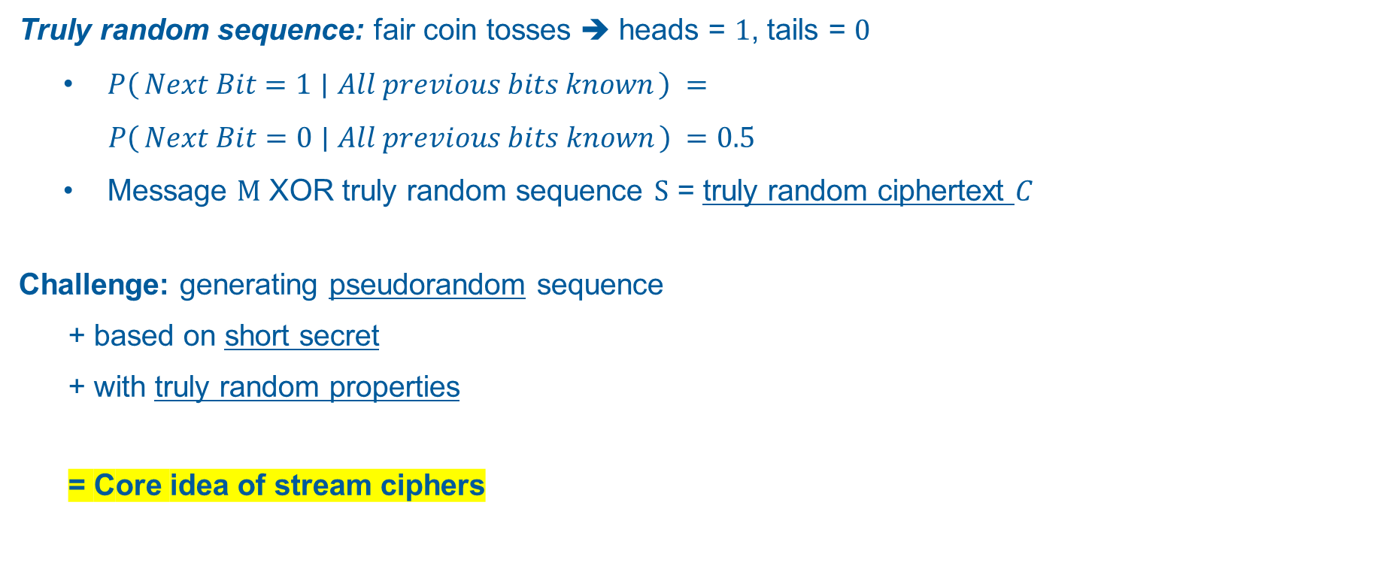
The Idea of Stream Ciphers
Pseudorandomness: Generating Randomness
Truly random sequence: fair coin tosses ➔ heads = $1$, tails = $0$
$P\left(Next Bit=1 ∣ All previous bits known\right)$ $=$
$P\left(Next Bit=0 ∣ All previous bits known\right) =0.5$
Message $M$ XOR truly random sequence $S$ = truly random ciphertext $C$
Challenge: generating pseudorandom sequence
+ based on short secret
+ with truly random properties
= Core idea of stream ciphers
Based on: [4, p. 234]

Slide 6
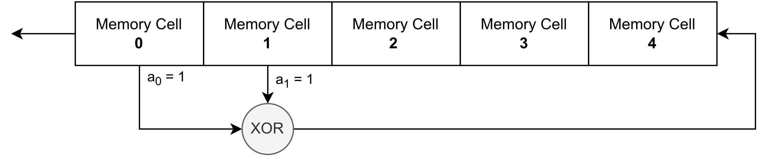

Linear Feedback Shift Registers (LFSRs)
Popular tool for stream ciphers: $\sim 80$ years of research history
Reason for popularity: mathematical interpretability
Tapped Cells
Based on: [4, p. 430]
Feedback Function

Slide 7
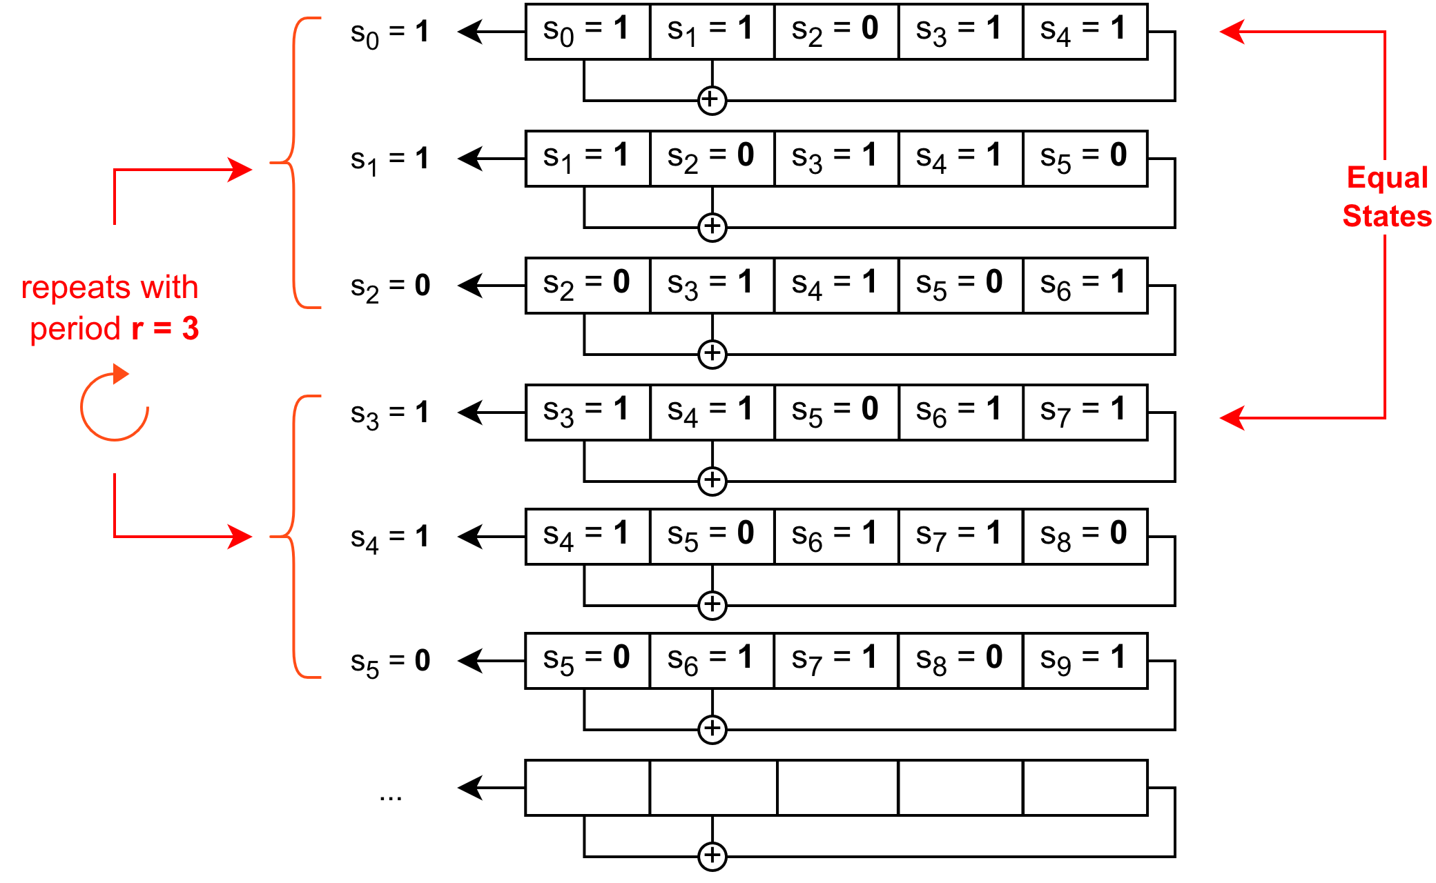
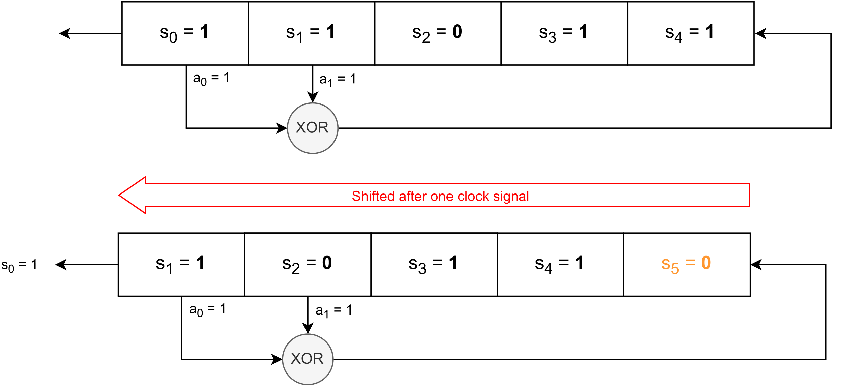

Linear Feedback Shift Registers (LFSRs)
Generating Pseudorandom Numbers with LFSRs
Bit $s_{n+k}$calculated by feedback function after $n$-th shift:
$s_{0}$, $s_{1}$, …, $s_{k−1}$ := initial state and $a$₀, $a$₁, …, $a_{k−1}$ := tapped memory cells
Example k = 5
$s_{5}$= ${a\text{0}s}_{0}+{a1s}_{1}=1+1=0 ($ℤ/2ℤ)
Period $r$:
$s_{n+r}=s_{n}$for all $n≥n_{0}$ with $r{, n}_{0}∈ℕ$
Maximum possible period $r=2^{k}−1$
Period can depend on initial state s₀, s₁, …, s_{k-1}
$s_{n+k}=a_{k−1}s_{n+k−1}+a_{k−2}s_{n+k−2}+ … +a_{0}s_{n}$ with ${s_{i},a}_{i}$∈ IF₂ (≙ ℤ/2ℤ)

Slide 8


Linear Feedback Shift Registers (LFSRs)
Optimizing LFSRs: m-sequences
Desired: maximum period + independent of initial state ➔ m-sequences
Producing m-sequences:
Describing the LFSR as matrix A ∈ IF₂^{k×k} :
Characteristic polynomial of A :
→ LFSR produces m-sequence, if characteristic polynomial of A is primitive
$$\left(\begin{matrix}0 & 0 & 0 & … & 0 & a_{0} \\ 1 & 0 & 0 & … & 0 & a_{1} \\ 0 & 1 & 0 & … & 0 & a_{2} \\ ⋮ & ⋮ & ⋮ & & ⋮ & ⋮ \\ 0 & 0 & 0 & … & 1 & a_{k−1}\end{matrix}\right)$$
with $a_{i}$:= tapped variables
$$f\left(x\right)=det\left(xI−A\right)= x^{k}+a_{k−1}x^{k−1}+a_{k−2}x^{k−2}+…+ a_{0}∈{\text{IF}}_{2} \left[x\right]$$

Slide 9
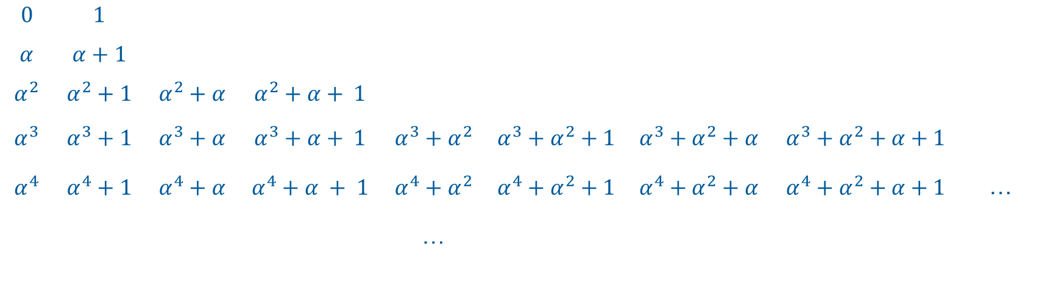

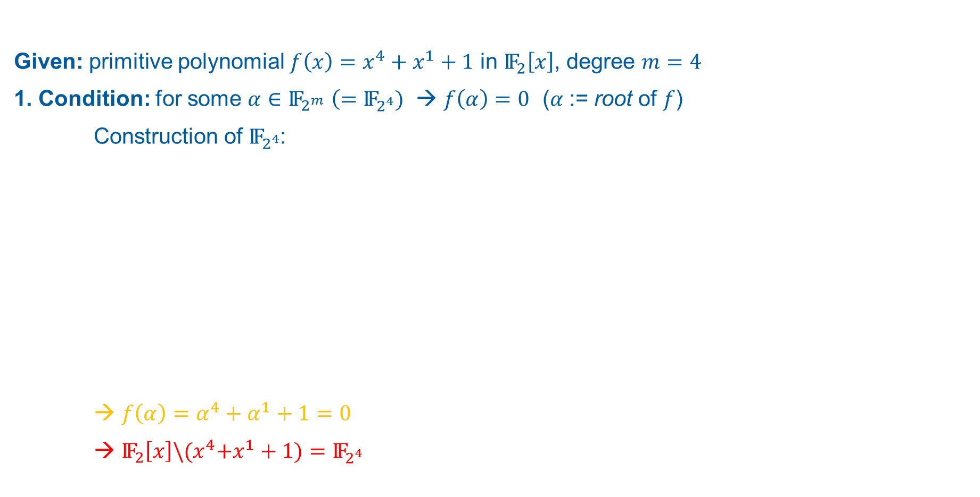



Linear Feedback Shift Registers (LFSRs)
m-sequences: Primitive Polynomials
Given: primitive polynomial $f\left.\left(x\right.\right)=x^{4}+x^{1}+1$ in ${\text{IF}}_{2}\left[x\right]$, degree $m=4$
1. Condition: for some $\text{α}∈{\text{IF}}_{2^{m}}$ $\left(={\text{IF}}_{2^{4}})\right.$ → $f\left.\left(α\right.\right)=0$ (𝛼 := root of $f$)
Construction of ${\text{IF}}_{2^{4}}$:
→ $f\left.\left(α\right.\right)={\text{α}}^{4}+{\text{α}}^{1}+1=0$
→ ${\text{IF}}_{2}\left[x\right]\backslash {(x}^{4}+x^{1}+1)={\text{IF}}_{2^{4}}$
$$0$$ | $$1$$
$$\text{α}$$ | $$\text{α}+1$$
$${\text{α}}^{2}$$ | $${\text{α}}^{2}+1$$ | $${\text{α}}^{2}+\text{α}$$ | $${\text{α}}^{2}+\text{α}+ 1$$
$${\text{α}}^{3}$$ | $${\text{α}}^{3}+1$$ | $${\text{α}}^{3}+\text{α}$$ | $${\text{α}}^{3}+\text{α}+ 1$$ | $${\text{α}}^{3}+{\text{α}}^{2}$$ | $${\text{α}}^{3}+{\text{α}}^{2}+1$$ |  | $${\text{α}}^{3}+{\text{α}}^{2}+\text{α}$$ | $${\text{α}}^{3}+{\text{α}}^{2}+\text{α}+1$$
$${\text{α}}^{4}$$ | $${\text{α}}^{4}+1$$ | $${\text{α}}^{4}+\text{α}$$ | $${\text{α}}^{4}+\text{α} + 1$$ | $${\text{α}}^{4}+{\text{α}}^{2}$$ | $${\text{α}}^{4}+{\text{α}}^{2}+1$$ |  | $${\text{α}}^{4}+{\text{α}}^{2}+\text{α}$$ | $${\text{α}}^{4}+{\text{α}}^{2}+\text{α}+1$$ | …
 |  |  |  | …
$${\text{IF}}_{2^{4}}$$
$${\text{IF}}_{2}\left[x\right]$$
$${\text{α}}^{4}+\text{α} + 1$$
$$"=0 "$$
$$=0+{\text{α}}^{2}={\text{α}}^{2}$$

Slide 10
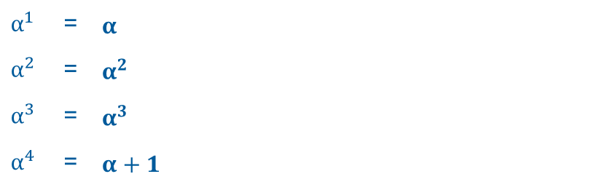
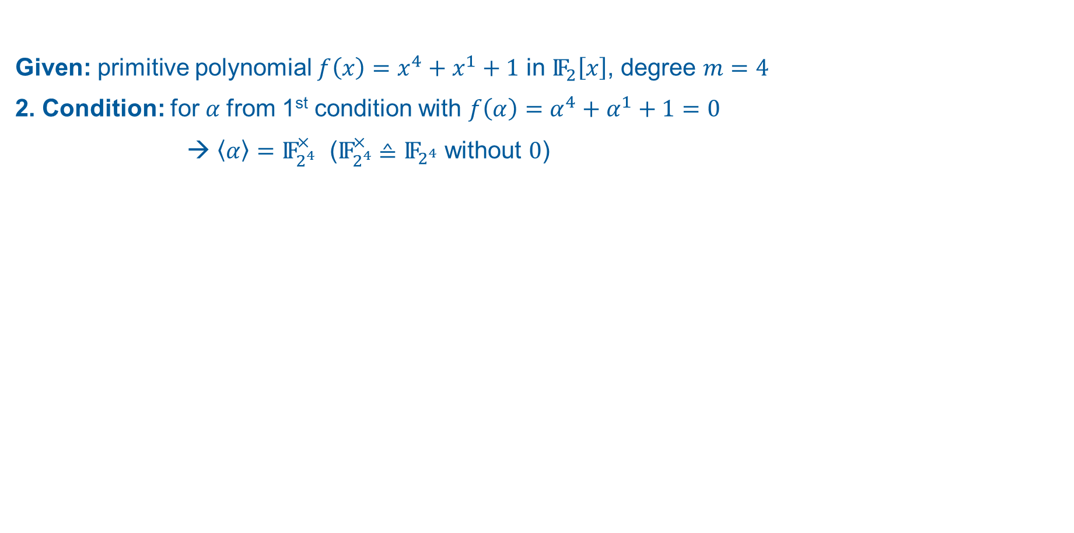
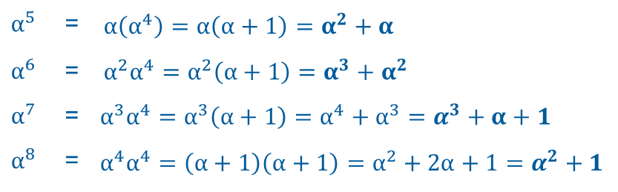
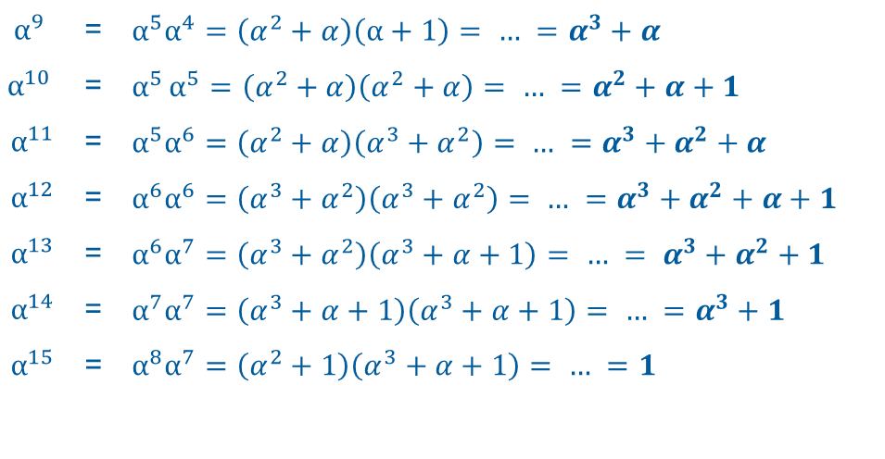
Linear Feedback Shift Registers (LFSRs)
m-sequences: Primitive Polynomials
Given: primitive polynomial $f\left.\left(x\right.\right)=x^{4}+x^{1}+1$ in ${\text{IF}}_{2}\left[x\right]$, degree $m=4$
2. Condition: for 𝛼 from 1st condition with $f\left.\left(α\right.\right)={\text{α}}^{4}+{\text{α}}^{1}+1=0$
→ $\left.\left\langle α\right.\right\rangle ={\text{IF}}_{2^{4}}^{×}$ (${\text{IF}}_{2^{4}}^{×}$ ≙ ${\text{IF}}_{2^{4}}$ without $0$)
$$α^{1}$$ | = | $$α$$
$$α^{2}$$ | = | $$α^{2}$$
$$α^{3}$$ | = | $$α^{3}$$
$$α^{4}$$ | = | $α+1$
$$α^{9}$$ | = | $$α^{5}\left.α^{4}\right.=\left(α^{2}+α\right)\left(α+1\right)= … =α^{3}+α$$
$$α^{10}$$ | = | $$α^{5}\left.α^{5}\right.=\left(α^{2}+α\right)\left(α^{2}+α\right)= … =α^{2}+α+1$$
$$α^{11}$$ | = | $$α^{5}\left.α^{6}\right.=\left(α^{2}+α\right)\left(α^{3}+α^{2}\right)= … =α^{3}+α^{2}+α$$
$$α^{12}$$ | = | $$α^{6}\left.α^{6}\right.=\left(α^{3}+α^{2}\right)\left(α^{3}+α^{2}\right)= … =α^{3}+α^{2}+α+1$$
$$α^{13}$$ | = | $$α^{6}\left.α^{7}\right.=\left(α^{3}+α^{2}\right)\left(α^{3}+α+1\right)= … = α^{3}+α^{2}+1$$
$$α^{14}$$ | = | $$α^{7}\left.α^{7}\right.=\left(α^{3}+α+1\right)\left(α^{3}+α+1\right)= … =α^{3}+1$$
$$α^{15}$$ | = | $$α^{8}\left.α^{7}\right.=\left(α^{2}+1\right)\left(α^{3}+α+1\right)= … =1$$
$$α^{5}$$ | = | $$α\left(α^{4}\right)=α\left(α+1\right)=α^{2}+α$$
$$α^{6}$$ | = | $$α^{2}\left.α^{4}\right.=α^{2}\left(α+1\right)=α^{3}+α^{2}$$
$$α^{7}$$ | = | $$α^{3}\left.α^{4}\right.=α^{3}\left(α+1\right)=\left.α^{4}+α^{3}\right.=α^{3}+α+1$$
$$α^{8}$$ | = | $$α^{4}\left.α^{4}\right.=\left(α+1\right)\left(α+1\right)=α^{2}+2α+1=α^{2}+1$$

Slide 11
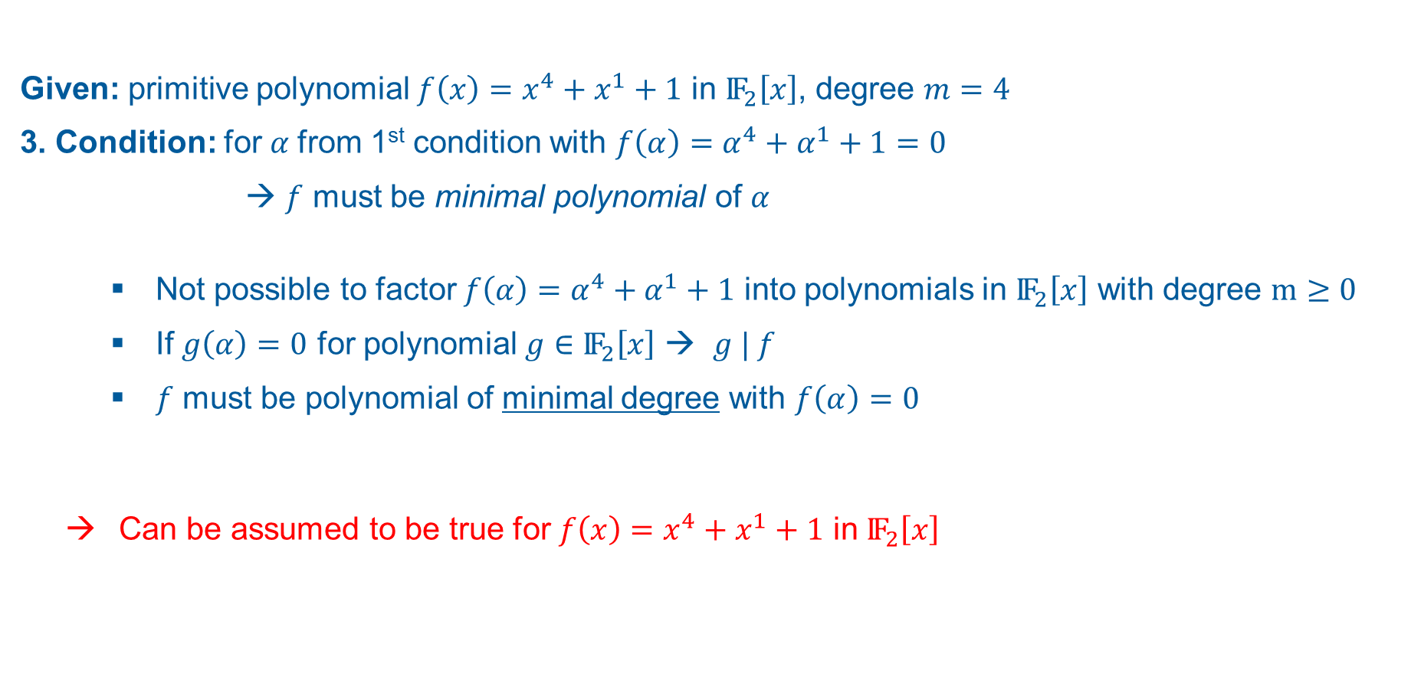
Linear Feedback Shift Registers (LFSRs)
m-sequences: Primitive Polynomials
Given: primitive polynomial $f\left.\left(x\right.\right)=x^{4}+x^{1}+1$ in ${\text{IF}}_{2}\left[x\right]$, degree $m=4$
3. Condition: for 𝛼 from 1st condition with $f\left.\left(α\right.\right)={\text{α}}^{4}+{\text{α}}^{1}+1=0$
→ $f$ must be minimal polynomial of 𝛼
Not possible to factor $f\left.\left(α\right.\right)={\text{α}}^{4}+{\text{α}}^{1}+1$ into polynomials in ${\text{IF}}_{2}\left[x\right]$ with degree $m≥0$
If $g\left.\left(α\right.\right)=0$ for polynomial $g$ $∈$ ${\text{IF}}_{2}\left[x\right]$ → $g | f$
$f$ must be polynomial of minimal degree with $f\left.\left(α\right.\right)=0$
Can be assumed to be true for $f\left.\left(x\right.\right)=x^{4}+x^{1}+1$ in ${\text{IF}}_{2}\left[x\right]$

Slide 12
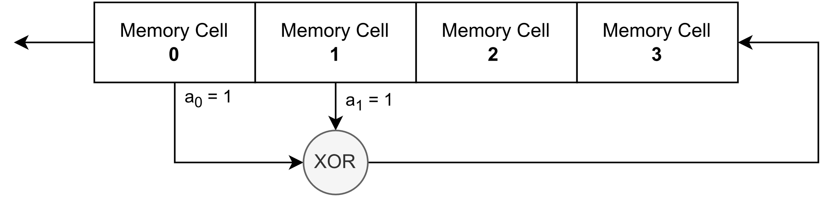
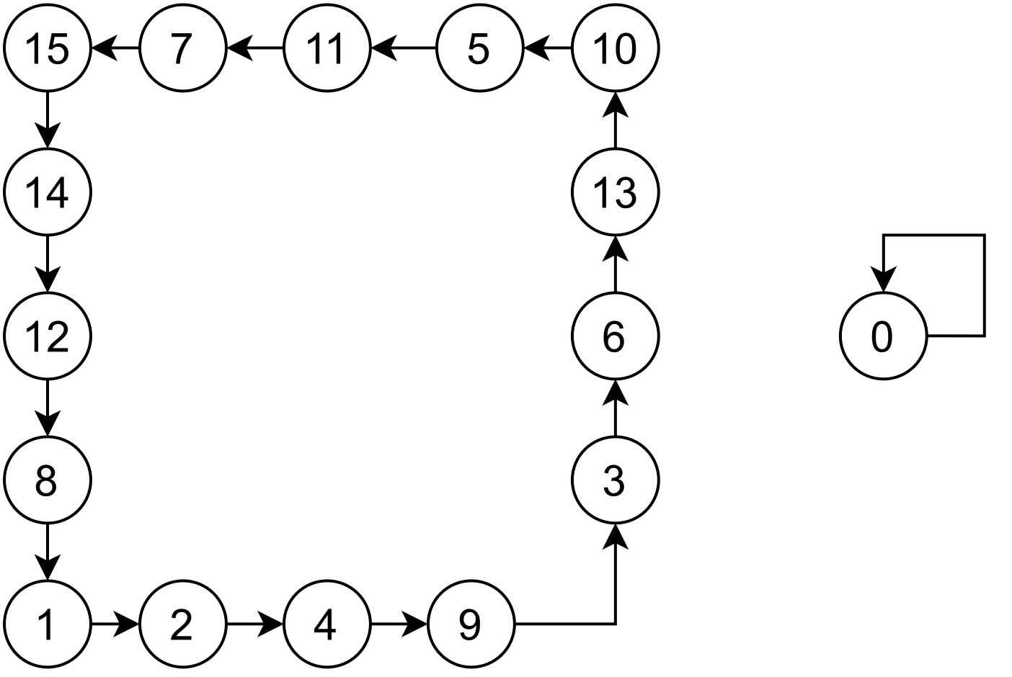
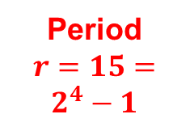
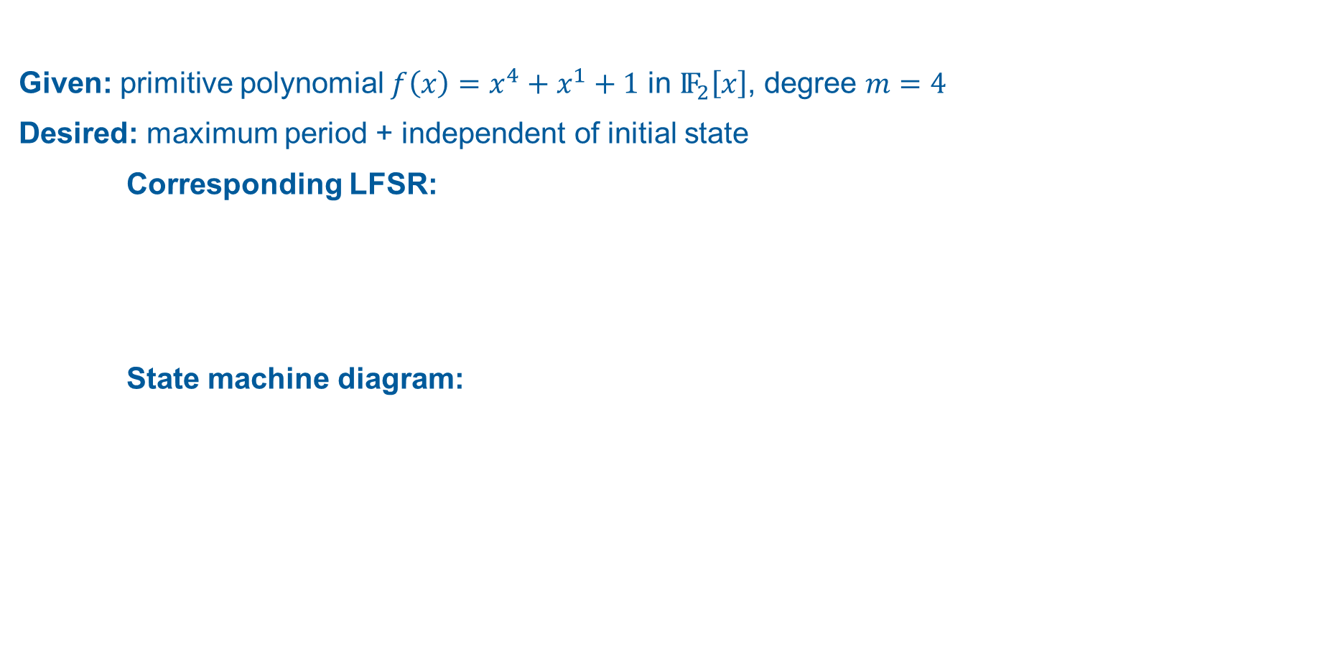
Linear Feedback Shift Registers (LFSRs)
m-sequences: Example
Given: primitive polynomial $f\left.\left(x\right.\right)=x^{4}+x^{1}+1$ in ${\text{IF}}_{2}\left[x\right]$, degree $m=4$
Desired: maximum period + independent of initial state
Corresponding LFSR:
State machine diagram:
Based on: [4, p. 430]
→ Requirements satisfied
Period
$r=15=2^{4}−1$
Based on: [11, pp. 230-232]

Slide 13
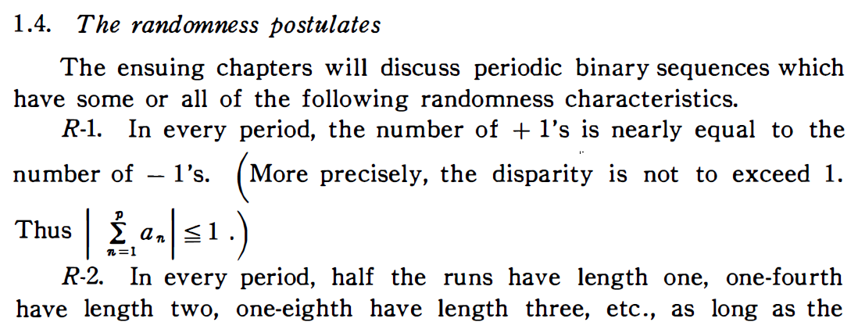
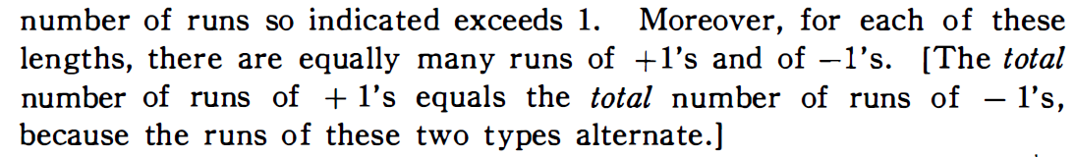
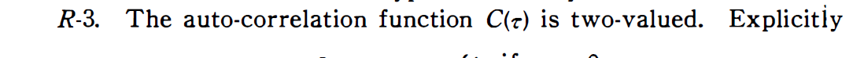

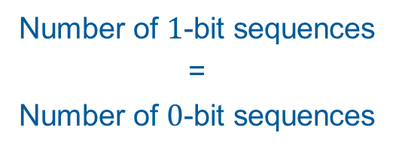

Linear Feedback Shift Registers (LFSRs)
m-sequences: Statistical Properties
1967: Solomon Golomb‘s Randomness Postulates ➔ fulfilled by m-sequences
Number of $1$-bits ≈ Number of $0$-bits
Number of $1$-bit sequences = Number of $0$-bit sequences
$$\left|11\right|=\left|00\right|$$
$$\left|111\right|=\left|000\right|$$
$$\left|1111\right|=|0000|$$
$$…$$
[8, p. 25]
→ Statistically secure
= cryptographically secure? …

